Slide 1
Hypertension Pregnancy and Postpartum A Summary of Recommendations from the American College of Obstetricians and Gynecologists
Kaci Durbin, MD, FACOG

Slide 2
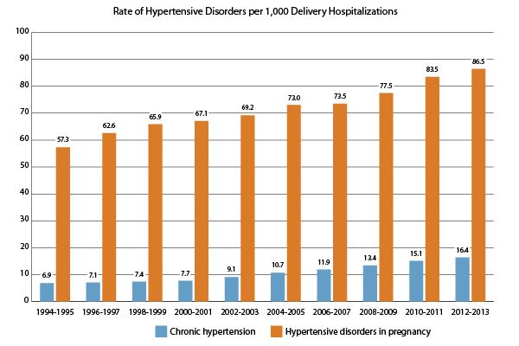
Incidence of Pregnancy Induced Hypertension
CDC. Data on Selected Pregnancy Complications in the United States. https://www.cdc.gov/reproductivehealth/maternalinfanthealth/pregnancy-complications-data.htm

Slide 3
Definitions
Hypertension
Systolic blood pressure 140 or higher
Diastolic blood pressure 90 or higher
Need 2 measurements at least 4 hours apart
(Unless severe range- if systolic 160+ or diastolic 110+, do not need to
wait)
Proteinuria
24 hour urine: 300mg protein or greater/24 hours
Urine protein/creatinine ratio: 0.3 or greater
(assuming each measured in identical units of mg/dL)
ACOG. Hypertension in Pregnancy: Report of the American College of Obstetricians and Gynecologists’ Task Force on Hypertension in Pregnancy. Obstet Gynecol. 2013; 122(5): 1122-1131.

Slide 4
Definitions
Chronic Hypertension
Hypertension detected prior to 20 weeks gestation
Gestational Hypertension
Hypertension developing after 20 weeks
Does not meet criteria for preeclampsia
Preeclampsia
Hypertension after 20 weeks + proteinuria
Hypertension after 20 weeks + one of the following
Platelets less than 100,000/microliter
LFTs elevated to twice normal concentration
Renal insufficiency (creatinine 1.1 or greater or doubling of serum creatinine)
Pulmonary edema
New onset cerebral or visual disturbances
Chronic Hypertension with Superimposed Preeclampsia
New onset proteinuria after 20 weeks
Sudden exacerbation of hypertension
Sudden manifestation of other signs/symptoms
Platelets less than 100,000/microliter
LFTs elevated to twice normal concentration
Renal insufficiency (creatinine 1.1 or greater or doubling of serum creatinine)
Pulmonary edema
New onset cerebral or visual disturbances
ACOG. Hypertension in Pregnancy: Report of the American College of Obstetricians and Gynecologists’ Task Force on Hypertension in Pregnancy. Obstet Gynecol. 2013; 122(5): 1122-1131.

Slide 5
Definitions
Preeclampsia without severe features
Formerly mild preeclampsia
Preeclampsia with severe features
Formerly severe preeclampsia
Includes the following:
Systolic blood pressure of 160 or higher or diastolic blood pressure of 110mmHg or higher on 2 occasions at least 4 hours apart while patient on bedrest
Platelets less than 100,000/microliter
LFTs to twice normal concentration, severe persistent RUQ or epigastric pain unresponsive to medication
Creatinine over 1.1mg/dL or a doubling of serum creatinine
Pulmonary edema
New-onset cerebral or visual disturbances
ACOG. Hypertension in Pregnancy: Report of the American College of Obstetricians and Gynecologists’ Task Force on Hypertension in Pregnancy. Obstet Gynecol. 2013; 122(5): 1122-1131.

Slide 6
Measuring Blood Pressure
Obtain correct size cuff
Width of bladder 40% of circumference and encircle 80% of arm
Patient should be sitting or semi-reclined with back supported and arm at heart level
Patient to sit quietly for 5 minutes before blood pressure
Feet should be flat, legs NOT dangling, and legs uncrossed
DO NOT REPOSITION PATIENT TO EITHER SIDE TO OBTAIN A LOWER BLOOD PRESSURE
California Maternity Quality Care Collaborative. Improving Health Care Response to Preeclampsia: A California Quality Improvement Toolkit. 2013.

Slide 7
What is the Cause of Preeclampsia?
Placental Problem
Disruption of vascular remodeling and an anti-angiogenic response
Alterations in the maternal response
Dysregulation of placental oxygenation
Begins EARLY in pregnancy
Pennington KA, Schlitt JM, Jackson DL et al. Preeclampsia: Multiple approaches for a multifactorial diseasee. Disease Models and Mechanisms. 2012; 5: 9-18.

Slide 8
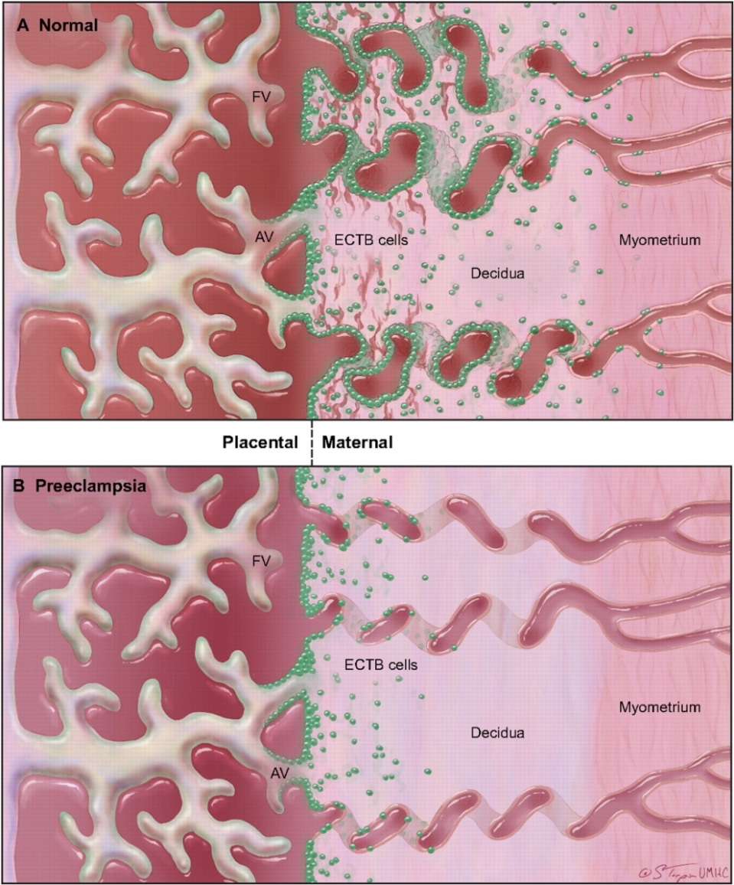
What is the Cause of Preeclampsia?
Normal Placenta:
--Cytotrophoblast cells (green) invade the endometrium and myometrium.
--Cytotrophoblast cells also replace the endothelial cells of the maternal spiral arteries (increasing vessel compliance and maximizing blood flow to the placenta)
Preeclamptic Placenta:
--Invasion is shallow and limited into the endometrium and myometrium
---Invasion into the spiral arteries is nearly absent; therefore the spiral arteries remain stiff and blood flow is NOT maximized to the placenta
Pennington KA, Schlitt JM, Jackson DL et al. Preeclampsia: Multiple approaches for a multifactorial diseasee. Disease Models and Mechanisms. 2012; 5: 9-18.

Slide 9
What is the Cause of Preeclampsia?
Poor trophoblast invasion is an early event in the disease
But is the poor invasion a CAUSE of preeclampsia or a RESULT?
Does the poor remodeling cause the placenta to be deprived of oxygen and then the hypoxia lead to the symptoms of preeclampsia?
Does hypoxia and the resulting decrease in placental perfusion cause a problem with trophoblast invasion?
Is the problem related to reperfusion injury and not the hypoxia itself?
Maybe the immune system is at fault? Do inflammatory cytokines from the immune system prevent angiogenesis and lead to oxygen deprivation?

Slide 10
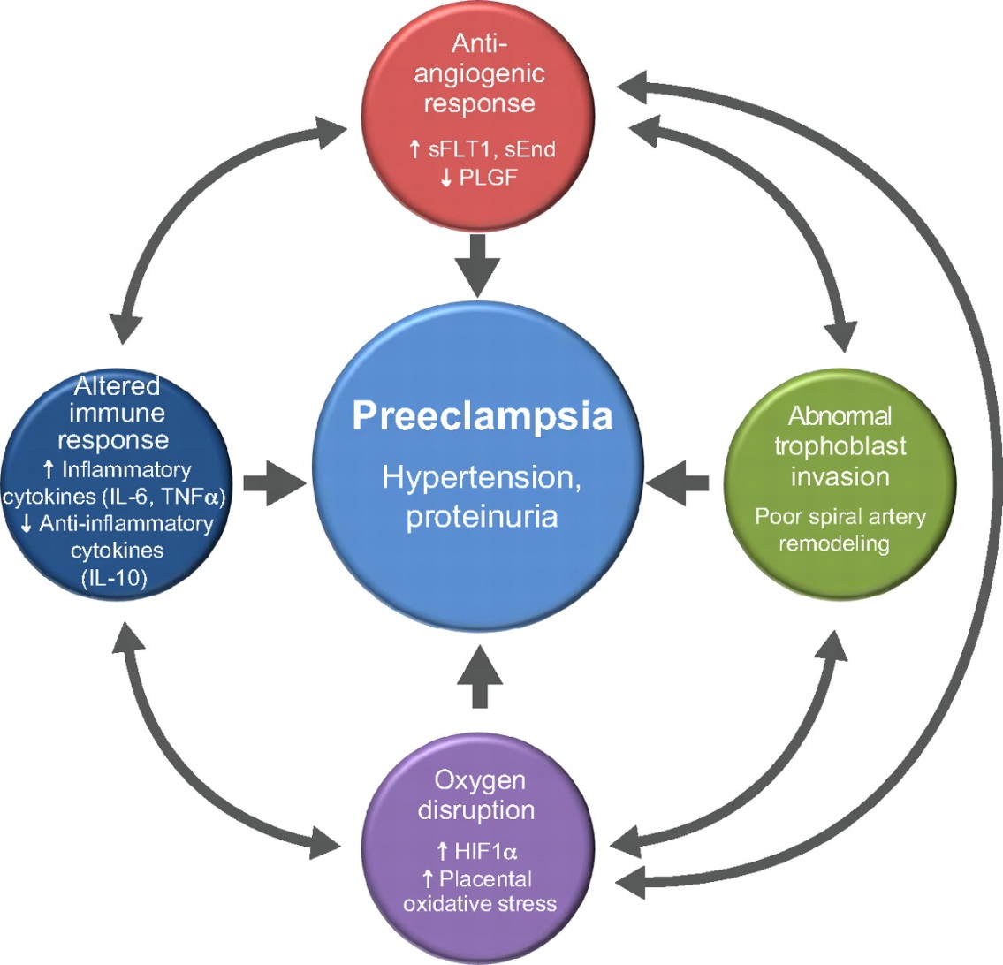
What is the Cause of Preeclampsia
Pennington KA, Schlitt JM, Jackson DL et al. Preeclampsia: Multiple approaches for a multifactorial diseasee. Disease Models and Mechanisms. 2012; 5: 9-18.

Slide 11
What is the Cause of Preeclampsia
Decrease in blood flow to the placenta
Mother develops hypertension to compensate
Increases blood flow to the placenta
Pennington KA, Schlitt JM, Jackson DL et al. Preeclampsia: Multiple approaches for a multifactorial diseasee. Disease Models and Mechanisms. 2012; 5: 9-18

Slide 12
Risk Factors for Preeclampsia
Primiparity
Previous preeclampsia
CHTN or chronic renal disease
History of thrombophilia
Multifetal pregnancy
In vitro fertilization
Family history of preeclampsia
Diabetes (pregestational)
Obesity
Systemic lupus erythematosus
Advanced maternal age (over 40)
ACOG. Hypertension in Pregnancy: Report of the American College of Obstetricians and Gynecologists’ Task Force on Hypertension in Pregnancy. Obstet Gynecol. 2013; 122(5): 1122-1131.

Slide 13
Initial Evaluation Things to Remember
THE AMOUNT OF PROTEINURIA DOES NOT PREDICT MATERNAL OR FETAL OUTCOME
Reviews of maternal mortality data reveal
Deaths can be avoided if treatment initiated early
Intervention in acutely ill women is sometimes delayed secondary to the absence of proteinuria
ACOG. Hypertension in Pregnancy: Report of the American College of Obstetricians and Gynecologists’ Task Force on Hypertension in Pregnancy. Obstet Gynecol. 2013; 122(5): 1122-1131.

Slide 14
Two Areas Stressed by ACOG
Deliver all women with gestational hypertension or preeclampsia (even without severe features) at 37 weeks
Increased postpartum surveillance and treatment
ACOG. Hypertension in Pregnancy: Report of the American College of Obstetricians and Gynecologists’ Task Force on Hypertension in Pregnancy. Obstet Gynecol. 2013; 122(5): 1122-1131.

Slide 15
Initial Evaluation Women with Suspected GHTN or Preeclampsia
History
Ask about symptoms of preeclampsia
(Headaches, visual changes, abdominal pain, N/V, SOA, weight gain)
Physical Exam
Swelling (lower and upper extremities, face)
RUQ or epigastric tenderness
Reflexes
Fetal Assessment
NST (+/- BPP if nonreactive)
+/- AFI and growth ultrasound
Laboratory Evaluation
CBC with platelet count
Serum creatinine
Liver enzymes
24 hour urine for protein OR urine protein/creatinine ratio
ACOG. Hypertension in Pregnancy: Report of the American College of Obstetricians and Gynecologists’ Task Force on Hypertension in Pregnancy. Obstet Gynecol. 2013; 122(5): 1122-1131.

Slide 16
Management Women with GHTN or Preeclampsia
Hospitalization and delivery for all women at 37 weeks or greater
Hospitalization and delivery for all women with suspected placental abruption
Hospitalization and delivery for all women 34 weeks or more with any of the following:
Preeclampsia with severe features
Labor or ruptured membranes
Estimated fetal weight less than the 5th %tile
Oligohydramnios
Persistent BPP 6/10 or less
ACOG. Hypertension in Pregnancy: Report of the American College of Obstetricians and Gynecologists’ Task Force on Hypertension in Pregnancy. Obstet Gynecol. 2013; 122(5): 1122-1131.

Slide 17
Management GHTN and Preeclampsia without Severe Features
If 37 weeks DELIVER
If 34 weeks or greater DELIVER for the following indications
Labor
Suspected abruption
Nonreassuring testing
Estimated fetal weight less than the 5th %tile
If less than 37 weeks and the prior indications not present
Antenatal testing and observation until 37 weeks
Daily fetal kick counts
No antihypertensives needed as long as systolic blood pressure less than 160mmHg and diastolic BP less than 110mmHg
No magnesium sulfate needed as long as blood pressures remain in the mild range (less than 160 systolic and less than 110 diastolic) and no severe features
ACOG. Hypertension in Pregnancy: Report of the American College of Obstetricians and Gynecologists’ Task Force on Hypertension in Pregnancy. Obstet Gynecol. 2013; 122(5): 1122-1131.

Slide 18
Management Preeclampsia with Severe Features
If 34 weeks or greater, DELIVER
If less than 34 weeks
Transfer to facility where MFM, NICU available
Start Betamethasone course
Start magnesium sulfate seizure prophylaxis
Loading dose of 6 grams
Maintenance 2g/hour
Start antihypertensive therapy for severe range blood pressures
First line treatment intravenous Labetalol
Goal is NOT normal blood pressure
ACOG. Hypertension in Pregnancy: Report of the American College of Obstetricians and Gynecologists’ Task Force on Hypertension in Pregnancy. Obstet Gynecol. 2013; 122(5): 1122-1131.

Slide 19
Management Preeclampsia with Severe Features
Can have vaginal delivery
If patient goes for Cesarean section, DO NOT DISCONTINUE THE MAGNESIUM
Both anesthesia induction and the stress of delivery can reduce the seizure threshold
Discontinuing magnesium will NOT abate the potential interactions of magnesium with anesthetic agents
Magnesium has a half life of 5 hours
Places the patient at risk for postpartum eclampsia
ACOG. Hypertension in Pregnancy: Report of the American College of Obstetricians and Gynecologists’ Task Force on Hypertension in Pregnancy. Obstet Gynecol. 2013; 122(5): 1122-1131.

Slide 20
Management During Labor
GHTN and Preeclampsia WITHOUT severe features
Vitals q 4 hours
I&O q 8 hours minimum
Lung exam q 4 hours
Assess for symptoms (edema, HA, visual changes, epigastric pain) every 8 hours
Continuous EFM
Preeclampsia WITH severe features
Vitals initially q5 minutes, then q 30 minutes during magnesium sulfate infusion if BPs stable
Continuous pulse oximetry
I&O assessment hourly
Lung exam q 2 hours
Assess for symptoms q 4 hours minimum
Continuous EFM
Improving Health Care Response to Preeclampsia: A California Quality Improvement Toolkit. California Maternal Quality Care Collaboration. November 2013

Slide 21
Management Postpartum HTN and Preeclampsia
All women with a diagnosis of GHTN, preeclampsia or superimposed preeclampsia
Need blood pressure monitoring for 72 hours postpartum (in hospital or outpatient)
Need follow up appointment to check blood pressure 7-10 days postpartum
For women with new-onset HTN postpartum
If severe features- need magnesium sulfate
For women with persistent postpartum hypertension
Treat with antihypertensives for systolic BP ≥ 150 or diastolic ≥ 100 (on at least 2 occasions 4 hours apart)
ACOG. Hypertension in Pregnancy: Report of the American College of Obstetricians and Gynecologists’ Task Force on Hypertension in Pregnancy. Obstet Gynecol. 2013; 122(5): 1122-1131.

Slide 22
Management of Severe Hypertension
ACOG recommends antihypertensive treatment for acute-onset, severe systolic (≥ 160) or severe diastolic (≥ 110) blood pressure if persistent for 15 minutes or more
Goal is preventing cerebral injury and infarction
First line treatment is intravenous Labetalol or intravenous Hydralazine
Oral Nifedipine may also be considered a first line agent
Goal is NOT normal blood pressure!
Ideal range is 140-150/90-100mmHg
ACOG. Emergent Therapy for Acute-Onset, Severe Hypertension During Pregnancy and the Postpartum Period. ACOG Committee Opinion #623. 2015 (Reaffirmed 2016).

Slide 23
Management of Severe Hypertension Labetalol First Protocol
Notify physician immediately for systolic BP ≥ 160 or diastolic BP ≥ 110 and institute fetal surveillance
If severe BP persistent for 15 minutes, give Labetalol 20mg IV (over 2 minutes)
Repeat BP in 10 minutes
If severe BP persistent, give Labetalol 40mg IV (over 2 minutes
Repeat BP in 10 minutes
If severe BP persistent, give Labetalol 80mg IV (over 2 minutes)
Repeat BP in 10 minutes
If severe BP persistent, give Hydralazine 10mg IV (over 2 minutes)
Repeat BP in 20 minutes
If severe BP persistent, obtain MFM, internal medicine, anesthesia, or critical care consultation
Once blood pressure goals achieved:
BP every 10 minutes for 1 hour, then every 15 minutes for 1 hour, then every 30 minutes for 1 hour, then hourly x 4 hours
ACOG. Emergent Therapy for Acute-Onset, Severe Hypertension During Pregnancy and the Postpartum Period. ACOG Committee Opinion #623. 2015 (Reaffirmed 2016).

Slide 24
Management of Severe Hypertension Hydralazine First Protocol
Notify physician immediately for systolic BP ≥ 160 or diastolic BP ≥ 110 and institute fetal surveillance
If severe BP persistent for 15 minutes, give Hydralazine 5 or 10mg (over 2 minutes)
Repeat BP in 20 minutes
If severe BP persistent, give Hydralazine 10mg (over 2 minutes
Repeat BP in 20 minutes
If severe BP persistent, give Labetalol 20mg IV (over 2 minutes)
Repeat BP in 10 minutes
If severe BP persistent, give Labetalol 40mg IV (over 2 minutes) and obtain MFM, internal medicine, anesthesia, or critical care consultation
Once blood pressure goals achieved:
BP every 10 minutes for 1 hour, then every 15 minutes for 1 hour, then every 30 minutes for 1 hour, then hourly x 4 hours
ACOG. Emergent Therapy for Acute-Onset, Severe Hypertension During Pregnancy and the Postpartum Period. ACOG Committee Opinion #623. 2015 (Reaffirmed 2016).

Slide 25
Management of Severe Hypertension Nifedipine First Protocol
Notify physician immediately for systolic BP ≥ 160 or diastolic BP ≥ 110 and institute fetal surveillance
If severe BP persistent for 15 minutes, give Nifedipine capsule 10 mg PO
Repeat BP in 20 minutes
If severe BP persistent, give Nifedipine capsule 20mg PO
Repeat BP in 20 minutes
If severe BP persistent, give Nifedipine capsule 20mg PO
Repeat BP in 20 minutes
If severe BP persistent, give Labetalol 40mg IV (over 2 minutes) and obtain MFM, internal medicine, anesthesia, or critical care consultation
Once blood pressure goals achieved:
BP every 10 minutes for 1 hour, then every 15 minutes for 1 hour, then every 30 minutes for 1 hour, then hourly x 4 hours
ACOG. Emergent Therapy for Acute-Onset, Severe Hypertension During Pregnancy and the Postpartum Period. ACOG Committee Opinion #623. 2015 (Reaffirmed 2016).

Slide 26
Eclampsia

Slide 27
Definitions
Eclampsia is defined as:
New-onset grand mal seizures in a woman with preeclampsia
Differential diagnosis includes:
Bleeding arteriovenous malformation (AVM)
Ruptured aneurysm
Idiopathic seizure disorder
(These more likely if seizure occurs after 48-72 hours postpartum or when seizures occur during magnesium sulfate treatment)
ACOG. Hypertension in Pregnancy: Report of the American College of Obstetricians and Gynecologists’ Task Force on Hypertension in Pregnancy. Obstet Gynecol. 2013; 122(5): 1122-1131.

Slide 28
Signs of Impending Eclampsia
Persistent occipital or frontal headaches
Blurred vision
Photophobia
Epigastric or right upper quadrant pain
Altered mental status
ACOG. Hypertension in Pregnancy: Report of the American College of Obstetricians and Gynecologists’ Task Force on Hypertension in Pregnancy. Obstet Gynecol. 2013; 122(5): 1122-1131.

Slide 29
Eclampsia Treatment
Supportive care for mother
Establish open airway and maintain breathing
Supplemental oxygen and pulse oximetry
Intubate if necessary
Obtain IV access
Supportive care for fetus
Left lateral decubitus position
Delivery once seizures controlled and blood pressure stabilized
Stop the seizure!
MAGNESIUM SULFATE
Loading dose of 4-6 grams
Maintenance dose of 1-2 grams/hour
Continue magnesium for at least 24 hours after the last convulsion
Remember- do NOT turn off magnesium infusion during Cesarean section
California Maternity Quality Care Collaborative. Improving Health Care Response to Preeclampsia: A California Quality Improvement Toolkit. 2013

Slide 30
Eclampsia Treatment
If still seizing despite magnesium sulfate…
Diazepam (Valium)
5-10mg IV (rate of 5mg/min) q 5-10 minutes
Maximum dose of 30mg
Lorazepam (Ativan)
4mg IV (rate of 2mg/min) q 5 min
Maximum dose of 8mg
Midazolam (Versed)
1-2mg IV (rate of 2mg/min) q 5 min
Maximum dose of 2mg
Phenytoin (Dilantin)
1000mg IV over 20 minutes

Slide 31
Magnesium Toxicity
Signs/Symptoms
Loss of deep tendon reflexes
Hypotension
Respiratory depression or arrest
Oliguria
Chest pain
EKG changes

Slide 32
Magnesium Toxicity
Treat with Calcium Gluconate
1 gram IV over 3 minutes
May repeat as necessary
Supportive care
Oxygen, intubation if necessary
Restrict fluids

Slide 33
References
ACOG. Hypertension in Pregnancy: Report of the American College of Obstetricians and Gynecologists’ Task Force on Hypertension in Pregnancy. Obstet Gynecol. 2013; 122(5): 1122-1131.
ACOG. Emergent Therapy for Acute-Onset, Severe Hypertension During Pregnancy and the Postpartum Period. ACOG Committee Opinion #623. 2015 (Reaffirmed 2016).
California Maternity Quality Care Collaborative. Improving Health Care Response to Preeclampsia: A California Quality Improvement Toolkit. 2013.
CDC. Data on Selected Pregnancy Complications in the United States. https://www.cdc.gov/reproductivehealth/maternalinfanthealth/pregnancy-complications-data.htm
Pennington KA, Schlitt JM, Jackson DL et al. Preeclampsia: Multiple approaches for a multifactorial diseasee. Disease Models and Mechanisms. 2012; 5: 9-18.

