Slide 1
Postpartum Hemorrhage Management Based on the California Collaborative Toolkit
Kaci Durbin, MD, FACOG

Slide 2
Maternal Physiology Overview*
Blood volume in a 60kg woman is 6L by 30 weeks
Uterine weight
Pre-Pregnancy: 40-70 grams
Third Trimester: 1200 grams
Uterine blood flow
Pre-Pregnancy receives 2% of cardiac output
Third trimester receives 17% of cardiac output
(600-800mL/minute!!)
California Maternal Quality Care Collaborative. A California Toolkit to Transform Maternity Care. Improving Healthcare Response to Obstetric Hemorrhage Version 2.0. A California Quality Improvement Toolkit. March 24, 2015

Slide 3
Postpartum Hemorrhage: Why is it Important?
Postpartum hemorrhage is the leading cause of maternal death worldwide¹
PPH in the U.S. has increased by 26% from 1994 to 2006²
50% increase in uterine atony
Over 50% of maternal deaths are preventable. Postpartum hemorrhage is the most preventable cause of maternal death²
Treatment delays
Pregnant women do not show early signs of blood loss
Lack of protocols, training
ACOG Practice Bulletin: Postpartum Hemorrhage. Number 76, October 2006.
California Maternal Quality Care Collaborative. A California Toolkit to Transform Maternity Care. Improving Healthcare Response to Obstetric Hemorrhage Version 2.0. A California Quality Improvement Toolkit. March 24, 2015.

Slide 4
What is PPH?
Varying Definitions
EBL >500mL vaginal or >1000mL Cesarean
Decrease in hematocrit >10%
Two types of postpartum hemorrhage
Primary (within 24 hours)
4-6% of pregnancies
80% caused by uterine atony
Secondary (24 hours, up to 12 weeks later)
1% of pregnancies
Etiology often unknown
Notes:
Hemoglobin is the concentration of hemoglobin, the major oxygen-carrying molecule in whole blood. Values may be expressed as grams of hemoglobin per 100 mL of whole blood (g/dL) or per liter of blood (g/L). Anemia is <12g/dL
Hematocrit (HCT), also called packed cell volume, is the packed spun volume of blood that consists of intact RBCs, expressed as a percentage. HCT can be measured directly following centrifugation of a blood sample. Anemia <36%

Slide 5
Symptoms of PPH
Symptoms (hypotension, pallor, dizziness) often does not occur until at least 10% of blood volume lost
THIS IS WHY ACCURATE EBL MEASUREMENT IMPORTANT!
Don’t wait for the patient to have symptoms!
ACOG Practice Bulletin: Postpartum Hemorrhage. Number 76, October 2006.

Slide 6
Symptoms of PPH*
At <1000mL orthostatic tachycardia occurs
15% deficit
At 1000-1500mL resting tachycardia and orthostatic hypotension occur
15-25% deficit
At 1500-2500mL resting hypotension and oliguria occur
25-40% deficit
Over 2500mL EBL leads to cardiovascular collapse; patient obtunded
>40% deficit
California Maternal Quality Care Collaborative. A California Toolkit to Transform Maternity Care. Improving Healthcare Response to Obstetric Hemorrhage Version 2.0. A California Quality Improvement Toolkit. March 24, 2015

Slide 7
Etiologies of PPH
Uterine atony
Lacerations or hematomas
Retained placenta
Coagulopathy
Uterine rupture
Uterine inversion

Slide 8
Risk Factors for PPH
Medium Risk
Prior Cesarean section or uterine surgery
Multiple gestation
>4 prior vaginal births
Chorioamnionitis
History of prior PPH
Large uterine fibroids
High Risk
Ongoing Risks (develop during labor)
Postpartum Risks

Slide 9
Risk Factors for PPH
Medium Risk
High Risk
Placenta previa or low-lying placenta
Suspected placenta accreta or percreta
Hematocrit <30 and other risk factors
Platelets <100,000
Active bleeding on admission
Known coagulopathy
Ongoing Risks (develop during labor)
Postpartum Risks

Slide 10
Risk Factors for PPH
Medium Risk
High Risk
Ongoing Risks (develop during labor)
Prolonged second stage of labor
Prolonged oxytocin use
Active bleeding
Chorioamnionitis
Magnesium sulfate treatment
Postpartum Risks

Slide 11
Risk Factors for PPH
Medium Risk
High Risk
Ongoing Risks (develop during labor)
Postpartum Risks
Vacuum or forceps assisted delivery
Cesarean delivery, especially urgent or emergent
Retained placenta

Slide 12
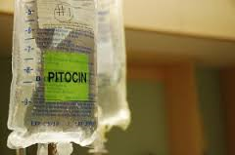
Prevention of PPH
ACTIVE MANAGEMENT OF THE THIRD STAGE WITH PITOCIN!!!*
*Active management of the third stage of labor with Oxytocin is recommended by the California Maternity Quality Care Collaborative, the American College of ObGyn (ACOG) and the World Health Organization

Slide 13
Treatment of PPH (2 goals)
Homeostasis (correct hypovolemia)
Stop the hemorrhage

Slide 14
Treatment of PPH: Homeostasis
IV fluids
Foley to monitor I/Os
Oxygen
Transfuse blood

Slide 15
Treatment of PPH: Stop the Hemorrhage
PITOCIN
Fundal massage
Additional Medical Management
Hemabate, Methergine, Cytotec
Uterine Tamponade
Packing, Foley, or Bakri Balloon
Surgical Management
Dilation and curettage
B-Lynch suture, hypogastric artery ligation, uterine artery ligation
Hysterectomy

Slide 16
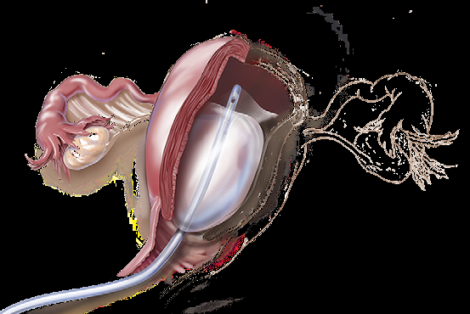
Bakri Balloon
Bakri balloon
Used for tamponade; applies pressure to uterine wall
Made of silicon (can be used with latex allergy)
What do you need
Balloon
60mL syringes
Normal saline (at least 500mL)
Foley catheter bag

Slide 17
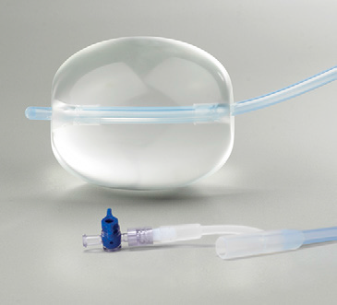
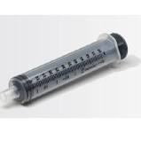
Bakri Balloon
Physician places balloon catheter into uterine cavity
Nurse inflates balloon with normal saline (up to 500mL)
Attach Foley bag to drainage catheter to monitor blood loss
Can tape catheter to patient’s leg with gentle traction

Slide 18
Blood Components
Packed red blood cells
Increase Hct by 3%, increase Hgb by 1g/dL
RBCs, WBCs and plasma (volume 200-240mL in 1 unit)
Should take 35-40 minutes for a crossmatch
First line product replacement
Fresh frozen plasma (FFP)
Increase fibrinogen by 10mg/dL
Fibrinogen, antithrombin III, factors V and VIII (180mL)
35-45 minutes to thaw
Give if over 2 units PRBCs given
Platelets
Increases platelet count by 5-10,000/mm3 per unit (6 pack platelets most common)
Platelets, RBCs, WBCs, plasma
Time varies
Give for platelets <50,000
Cryoprecipitate
Increases fibrinogen by 10mg/dL
Fibrinogen, factors VIII and XIII, vwf (lower volume)
35-45 minutes to thaw

Slide 19
Guideline for Replacing Blood: CMQCC Transfusion Guidelines*
Start with PRBCs
Use uncrossed until crossed blood available
After 2 units of PRBCs, ratio of PRBCs to FFP should be 1:1
Given 1 unit platelets for every 4-6 units of PRBCs
Remember- with acute blood loss, the Hgb/Hct will not change significantly for 4 hours

Slide 20
California Maternity Quality Care Collaborative*
Stage 0 - all births (risk assessment stage)
Stage 1 Hemorrhage
EBL >500mL vaginal or >1000mL Cesarean OR
Vital sign change >15% 0R
HR >110, BP <85/45, or O2 sat <95%
Above factors WITH CONTINUED BLEEDING
Stage 2 Hemorrhage
Continued bleeding from Stage 1, EBL <1500mL
You are ready to start transfusing PRBCs
Vital sign instability
Stage 3 Hemorrhage
Continued bleeding with EBL >1500mL
Vital sign instability
Suspicion for DIC
*California Maternal Quality Care Collaborative. A California Toolkit to Transform Maternity Care. Improving Healthcare Response to Obstetric Hemorrhage Version 2.0. A California Quality Improvement Toolkit. March 24, 2015

Slide 21
Stage 0 Hemorrhage: All Patients
Active management of 3rd Stage
PITOCIN FOR EVERYONE
Use 10-40 units of Pitocin in 1 liter
Can also use Pitocin 10 units IM x 1
Risk Assessment
Type and cross anyone with a positive antibody screen
Type and cross HIGH risk patients
Previa, low-lying placentas, suspicion for accreta
Platelets less than 100,000
Hct less than 30% + additional risk factors
Active bleeding on admission
Coagulopathy
Accurately quantify EBL

Slide 22
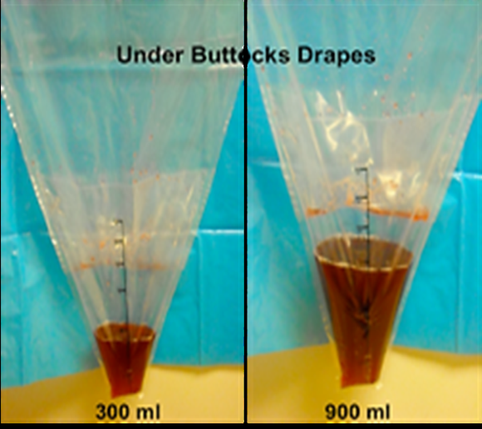
Quantifying Blood Loss
Assess EBL present in under-buttocks drape
Need to assess amniotic fluid volume immediately after delivery of baby!
Assess EBL in canisters (C/S suction)
Need to assess amniotic fluid in canister immediately after delivery of baby!
Obtain an EBL prior to any irrigation
Weigh blood-soaked items
Scale should be present in room
Weigh all pads, laps, sponges, etc.

Slide 23
Stage 1 Hemorrhage
GET HELP
Call OB if not already there
Get another RN in room
Ask someone to bring hemorrhage cart and scale
Activate the hemorrhage protocol (orderset)
Includes labs, type and cross for 2 units PRBCs
Vital signs, O2 sat q 5-15 minutes (give O2 if less than 95%)
Verify IV access
Measure EBL q 5-15 minutes
Increase oxytocin rate (run wide open)
Apply warm blankets
Fundal massage
Drain bladder
Give medications as prescribed by physician
Notes:
Physician is looking for cause (atony, retained POC, lacerations, hematomas).

Slide 24
Stage 2 Hemorrhage
Continue steps from Stage 1
Vitals/O2, EBL measurement q5-10 minutes
Continue Pitocin, fundal massage
New steps- primary nurse
Initiate Stage 2 of OB hemorrhage protocol
Includes labs, transfusion order, additional preparation of blood products
Place a 2nd IV
Set up blood warmer and blood administration set
Administer blood, medication, etc. as ordered
Keep patient warm
New steps- second nurse
Place Foley if not done already
Obtain blood products from blood bank, run to get ultrasound or OB hemorrhage cart
Assist with move to OR (if indicated)
Notes:
Physician is ordering additional meds as needed, may be doing curettage or fixing lacerations.
Blood bank is thawing 2-4 FFP, preparing for possibility of massive hemorrhage

Slide 25
Stage 3 Hemorrhage
Continue prior steps
Vital signs, quantifying EBL q5-10 minutes
Keep patient warm (Bair Hugger)
New steps- primary nurse
Apply SCDs
Aggressively transfuse patient
Use blood warmer and rapid infuser
(1:1 ratio of PRBCs to FFP, 1 platelet pack per 4-6 PRBCs)
Second nurse
Continue to administer medication, blood products, draw labs as ordered
HELP MOVE TO OR if not already there
Third nurse
Recorder
Notes:
MOVE TO OR if not already there!

Slide 26
Commonly Used Medications
Drug | Dose | Method | Frequency | Side Effects | Contra-indications | Storage
Pitocin | 10-40 units/500-1000mL NS | IV | Continuous | Usually none (Avoid IV push) | Hypersensitivity to drug | Room temp
Methergine (0.2mg/mL) | 0.2mg | IM | Q 2-4 hours | N/V, hypertension (severe if IV) | HTN, CV disease, hypersensitivity to drug (CAUTION IF USED WITH EPHEDRINE) | Refrigerate
Hemabate (250mcg/mL) | 250mcg | IM | Q 15-90 minutes (Max 8 doses in 24 hours) | N/V, diarrhea, headaches, chills, bronchospasm, hypertension | Caution in hepatic disease, asthma, HTN, cardiac or pulmonary disease. Drug hypersensitivity | Refrigerate
Cytotec (100 or 200mcg tab) | 800mcg | Oral, sublingual, rectal | Once | N/V, diarrhea, chills, fever, headache | Hypersensitivity to drug | Room temp

Slide 27
Questions?

Slide 28
Scenario 1
32yo G5P4 with no prenatal care arrives from the ED at C/C/+1
States she started contracting about 2 hours ago
Membranes ruptured 45 minutes ago
Reports a PMH of asthma. Uses albuterol PRN
No PSH
NKDA
No significant FH
Smokes ½ ppd
Notes:
Risk factors for PPH? (4 prior SVDs). What should you be doing now to prevent/prepare for a PPH? (Place IV, order type & cross with labs, PITOCIN in room, set up to measure EBL, etc.)

Slide 29
Scenario 1
Patient pushes effectively and delivers in one contraction, OA position
Placenta delivers quickly
Notes:
Start measuring EBL. Is IV in yet? What if it isn’t? IM Pitocin? Are you checking vitals?

Slide 30
Scenario 1
Patient pushes effectively and delivers in one contraction, OA position
Placenta delivers quickly
Physician tells you the uterus is boggy and asks if Pitocin has been started
He/she asks you what the patient’s vitals are

Slide 31
Scenario 1
Physician asks for Hemabate and Methergine
EBL now 500mL
What do you think is going on with the patient?
Notes:
Do you give the Hemabate? Remember- asthma. Did you give Methergine? What is her BP? (EBL 500mL- now a Stage 1 PPH- type and cross if not done already! Start Stage 1 Hemorrhage protocol (IV, Pitocin, vitals, weigh blood, empty bladder, keep patient warm) What else could be going on? (Atony, retained POC, lacs, etc.)

Slide 32
Scenario 1
Methergine given
Cytotec ordered
Patient has an IV, you are continuing VS and EBL measurements. Bladder drained. Warm blankets over her.
Patient continues to bleed
Blood pressure 120/78, HR 115
EBL now 800mL
Next steps?
Notes:
Stage 2 hemorrhage? You want to initiate stage 2- notifies blood bank to prepare for massive transfusion. Establish a second IV, set up blood administration set and warmer. Second nurse- place Foley, obtain blood products or move to OR if needed

Slide 33
Scenario 1

Slide 34
Scenario 1
Blood pressure slightly decreased to 105/60. HR up to 120. EBL now 1100.
Transfusing 2 units PRBCs
Methergine and Cytotec have been given
Foley in place, patient has an IV in each arm now
Physicians tells you uterus still boggy
What next?
Notes:
Bakri balloon?

Slide 35
Scenario 1
What do you need to get for Bakri?

Slide 36
Scenario 1
What do you need to get for Bakri?
Saline and 60mL syringes
Balloon
Foley bag

Slide 37
Scenario 1
BP still 100/60, HR 120.
Cumulative EBL 1300mL
Bakri now in place with 400mL
Minimal bleeding noted
Notes:
What if the bleeding did not stop? What would happen at EBL over 1500ml?

Slide 38
Scenario 2
You are working in postpartum
24yo G1P1 3 hours s/p SVD of a 7lb LVMI
No PMH or PSH, nonsmoker. Uncomplicated pregnancy
Delivery of infant uncomplicated, EBL 200mL
2nd degree midline laceration repaired with vicryl
Manual removal of placenta

Slide 39
Scenario 2
Patient complains of feeling dizzy and thinks she is bleeding
Stands up and pad under her completely saturated; clots pouring onto the floor
Next steps?
Notes:
Get patient back in bed and call for help. Vital signs. Examine patient Measure EBL and notify physician. Does she still have IV access?

Slide 40
Scenario 2
Blood pressure sitting is 108/70. HR 125.
Fundus boggy
Second nurse comes to assist
Weighs pads while you start another IV
Anything else you should be doing?
Measures EBL at 1000mL
Notes:
Start intravenous fluids? Obtain hemorrhage meds, cart to bedside. Ultrasound to bedside. Initiate stage 1 OB hemorrhage protocol! (type and cross)

Slide 41
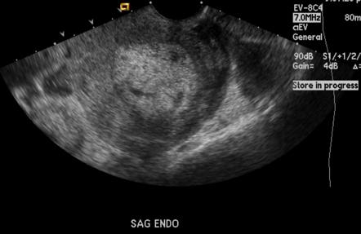
Scenario 2
Patient still bleeding
Physician arrives and starts bedside ultrasound
Appears consistent with retained products
What else should you be doing?
Notes:
Call anesthesia if not done, prepare for OR. Continue vitals, measuring EBL, keep patient warm. Place Foley. Second IV?

Slide 42
Scenario 2
Vitals now 98/58, HR 130
Total EBL measured at 1300mL
Continued vaginal bleeding
Prepare for OR (tech should be setting up room, anesthesia should be on way, foley in and SCDs on)
Initiate Stage 2 hemorrhage
Transfuse 2 units PRBCs!
If not available, uncrossmatched

Slide 43
Scenario 2
Dilation and curettage in OR
2 units PRBCs infusing
Patient now has stopped bleeding
Back to L&D with increased surveillance overnight

Slide 44
Scenario 3
30yo G2P0010 at 39 weeks arrives to L&D at 5cm with painful, frequent contractions
Prenatal care complicated by
Arcuate uterus
No PMH, PSH of D&C x 2
NKDA, nonsmoker
Receives epidural shortly after arrival
9/C/+1 after epidural
Delivers within 3 hours of arrival

Slide 45
Scenario 3
Delivers a LVFI, Apgars 9 and 9. 1st degree laceration
Placenta does not deliver initially
Laceration repaired while waiting on placental separation
With traction on cord, placenta delivers, along with what appears to be a mass protruding from the vagina; profuse vaginal bleeding occurs
What is going on?
Notes:
Uterine inversion, prolapsing fibroid

Slide 46
Scenario 3
Call for help!
Call 2nd nurse, anesthesia, prepare OR
Vital signs, measure EBL. Initiate Stage 1 OB hemorrhage. IV in place?
Obtain uterine relaxants so that the physician can attempt to replace the uterus

Slide 47
Scenario 3
Uterine relexants
Nitroglycerin
50mcg IV
Can give up to 4 additional doses
Terbutaline
0.25mg SC
Can give q15-30min x 3
Magnesium sulfate
4-6g IV

Slide 48
Scenario 3
Nitroglycerin given
Physician unsuccessful thus far in replacing uterus
BP 90/60, HR 130
Total EBL now 1200mL with continued hemorrhage
What to do?
Notes:
Initiate Stg 2 hemorrhage, second IV, foley, move to OR, start transfusing

Slide 49
Scenario 3
Nitroglycerin given
Physician unsuccessful thus far in replacing uterus
BP 90/60, HR 130
Total EBL now 1200mL with continued hemorrhage
What to do?
Initiate Stage 2 hemorrhage
Place second IV, Foley (if not done already), SCDs
Start transfusing PRBCs
Move to OR
Give additional medications

Slide 50
Scenario 3
Patient in OR, preparing for laparotomy
Has received Nitroglycerin and Terbutaline
Still bleeding (now EBL 1500mL)
2 units PRBCs infusing
What next?
Notes:
Stage 3 hemorrhage; prepare to transfuse additional blood products

Slide 51
Scenario 3
Patient in OR, preparing for laparotomy
Has received Nitroglycerin and Terbutaline
Still bleeding (now EBL 1500mL)
2 units PRBCs infusing
What next?
Stage 3 hemorrhage initiated
What do you prepare to transfuse?
Notes:
Stage 3 hemorrhage; prepare to transfuse additional blood products

Slide 52
Scenario 3
Prepare to transfuse an additional 2 units PRBCs with 2 units FFP
Blood bank should be preparing additional PRBCs, FFP, and platelets for use after that
Notes:
Stage 3 hemorrhage; prepare to transfuse additional blood products

Slide 53
Scenario 3
Surgery successful
PRBCs and FFP transfusing
To L&D or ICU for close monitoring
Notes:
Stage 3 hemorrhage; prepare to transfuse additional blood products

